Slide 1
<
Previous
(150x240)
>
Next
(150x240)
Dead Zone (20x240)

Slide 2
Status (320x20)
<
Previous
Event
(150x260)
20px Space
>
Next
Event
(150x260)
20px Space
Dim – (150x20)
Dim + (150x20)

Slide 3
Event Title
Microsoft Sans Serf 36px/27pt
Event Subtitle
Microsoft Sans Serf 20px/15pt
Countdown Label
Microsoft Sans Serf 20px/15pt
Countdown Number
Microsoft Sans Serf 36px/27pt
C:\Windows\fonts\micross.ttf
https://learn.adafruit.com/custom-fonts-for-pyportal-circuitpython-display/conversion
5/13/2023 3:41 PM Event 1 of 14
Event Image
Event Title
Event Subtitle
Countdown (Days, Hours, and Minutes)
Dim: Auto

Slide 4

Event Title
Microsoft Sans Serf 36px/27pt
Event Subtitle
Microsoft Sans Serf 20px/15pt
Countdown Label
Microsoft Sans Serf 20px/15pt
Countdown Number
Microsoft Sans Serf 36px/27pt
C:\Windows\fonts\micross.ttf
https://learn.adafruit.com/custom-fonts-for-pyportal-circuitpython-display/conversion
72.9° F
5/13/2023 3:41:12 PM
Event Image
Event Title
Event Subtitle
Countdown (Days, Hours, and Minutes)
1 of 18
Auto

Slide 5
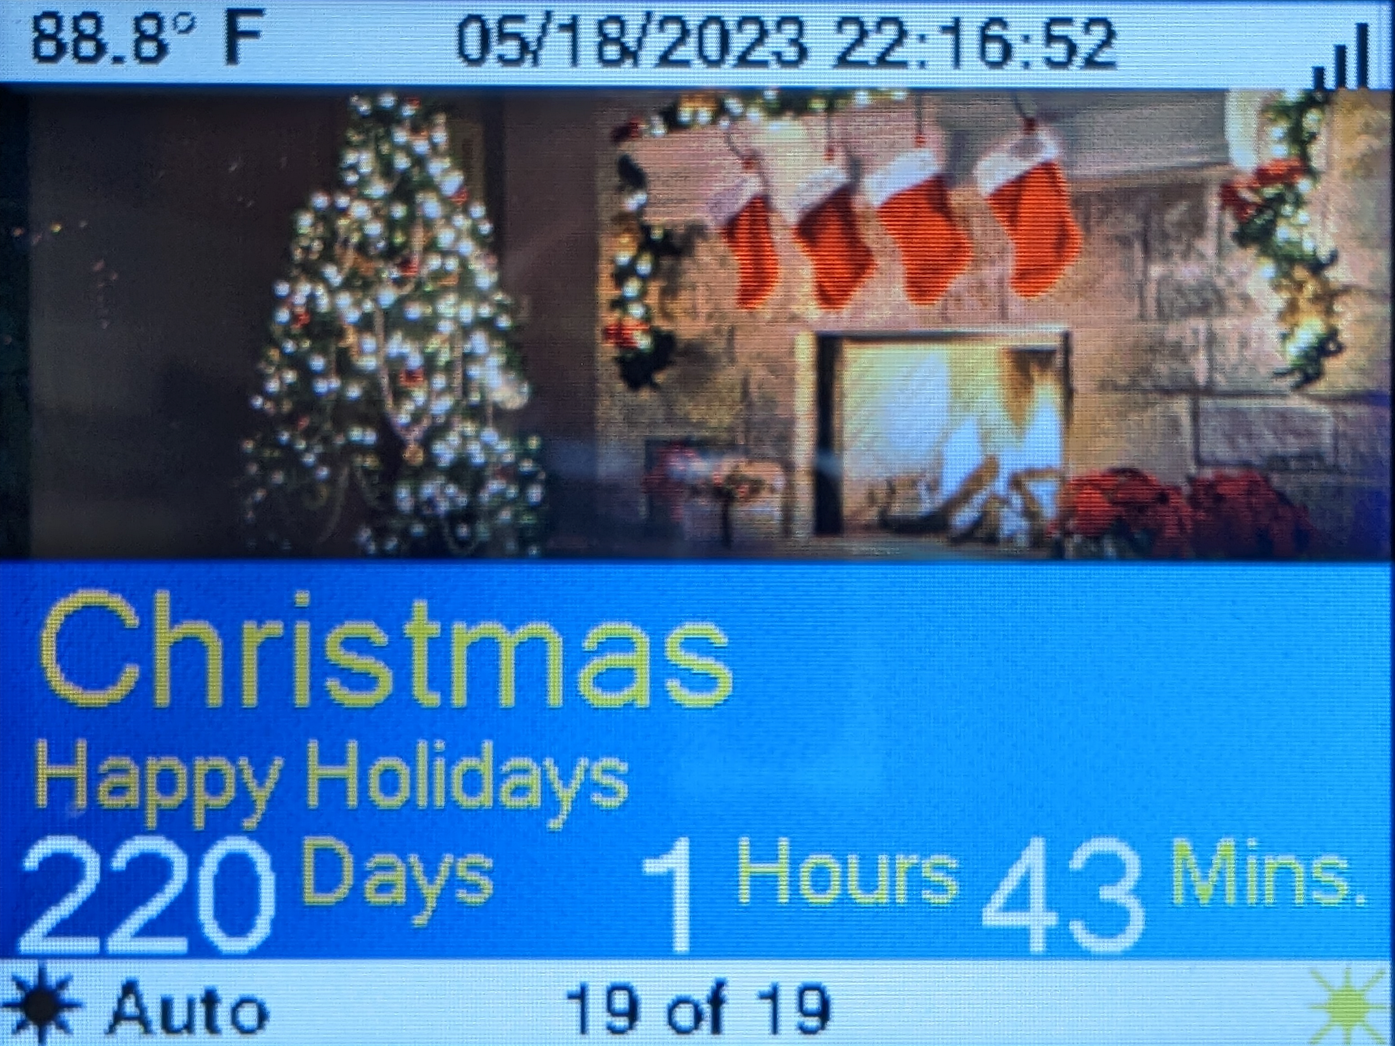
eventWindow (eventDisplay)
statusTemperature (Label)
statusDateTime (Label)
spritesWifi (Tile)
title (Label)
subtitle (Label)
countDays (Label)
countlabelDays (Label)
countHours (Label)
countlabelHours (Label)
countMinutes (Label)
countlabelMinutes (Label)
gpButtonDim (Group)
statusBrightness (Label)
statusEventCount (Label)
gpButtonBright (Group)
eventDayText (Label) *
NOTE: * eventDayText, is not shown. It replaces 6 through 11 on the day of the event.
1
2
3
4
5
6
8
10
7
9
11
12
13
14
15

